Slide 1

Unity Mobile Game
Project nº 42
Advisor:
Pedro Fazenda
Students:
André Faria 47455
Sara Nobre 47504

Slide 2
Game overview
01
Gameplay
02
Development tools
03
Table of contents
Inspiration
04
Concept and target audience
Objectives and core gameplay
Tools and platforms used
What inspired us to create it
Project management
05
Gantt chart
System
06
Attributes and functions
2/11

Slide 3

Game overview
A strategy turn-based rogue-like mobile game where the player progresses through the world utilizing cards and receiving rewards.
Genres:
Action
Turn based
Card battle
Rogue-like deck builder
Fantasy
Target audience:
Age around 15-30 years old.
Someone who uses mobile games to pass time.
3/11

Slide 4
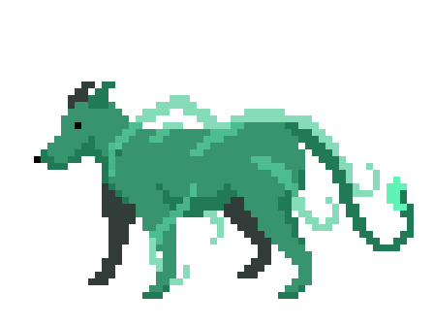
Objectives
Progress through rooms and acquire upgrades
Use those upgrades to reach the final room and beat the stage
Proceed to the next world and repeat…
4/11

Slide 5

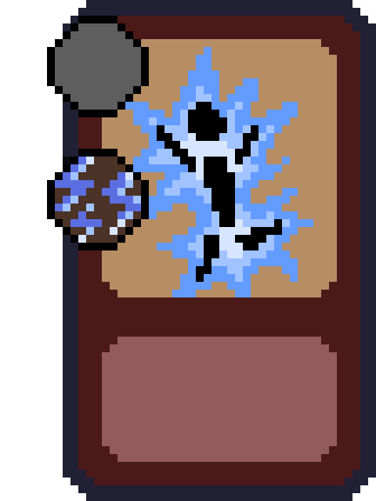


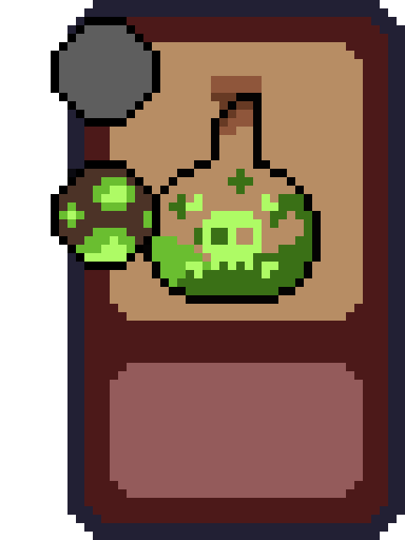
Core gameplay
Choose a path
Turn-based with a set energy limit
Use cards to attack and defeat enemies
Acquire upgrades that help in the next fights
Difficulty increases as player progresses
5/11

Slide 6





Development tools
Unity
Aseprite
Audacity
Figma
Google play
Engine used to develop the game
Software used to draw all the art
Editor used to create diagrams
Program used to record sound effects and music.
Platform used to release the game
6/11

Slide 7
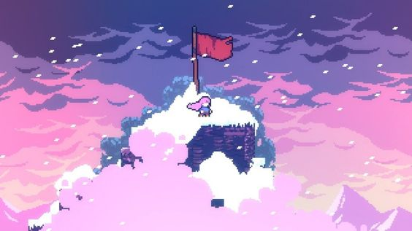
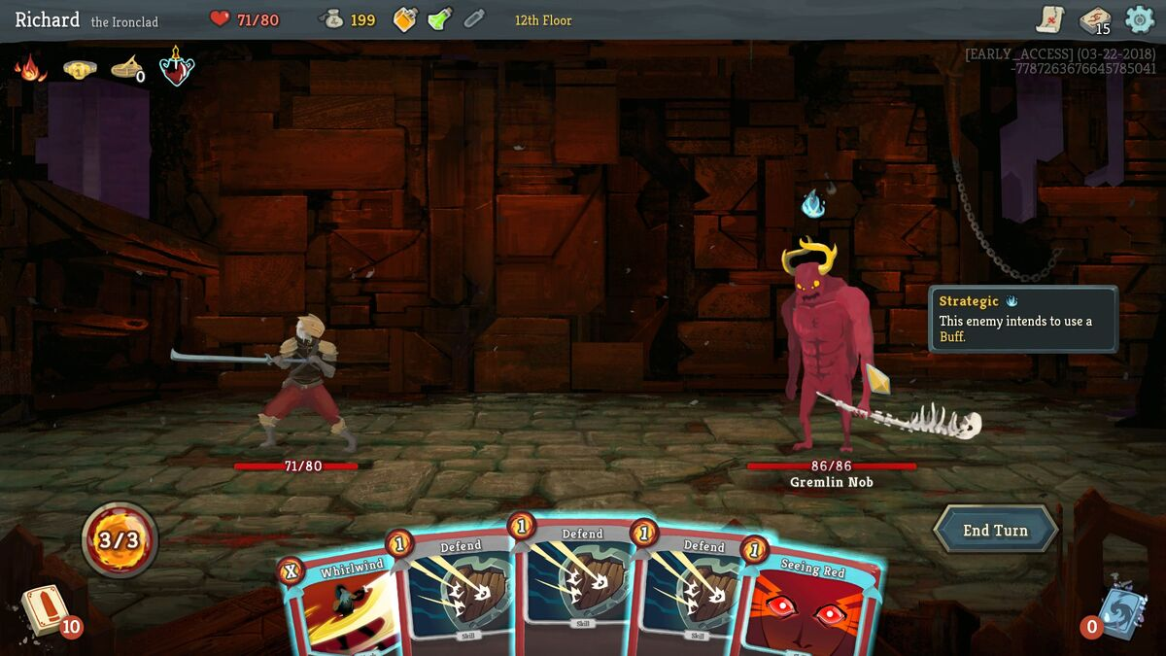
Inspiration
Celeste
Slay the Spire
Simple yet appealing pixel art
Turn-based deckbuilding gameplay
7/11

Slide 8
Gantt chart
8/11

Slide 9
System Functions
Requirements | Function | Category
R1 | The game must have a tutorial | Visible
R2 | The player must be able to control his actions | Visible
R3 | The player must be able to select the level he wants | Visible
R4 | Loading visuals and data needs to be quick | Invisible
R5 | The game must have music and sound effects | Visible
R6 | The game must save the user’s data | Invisible
9/11

Slide 10
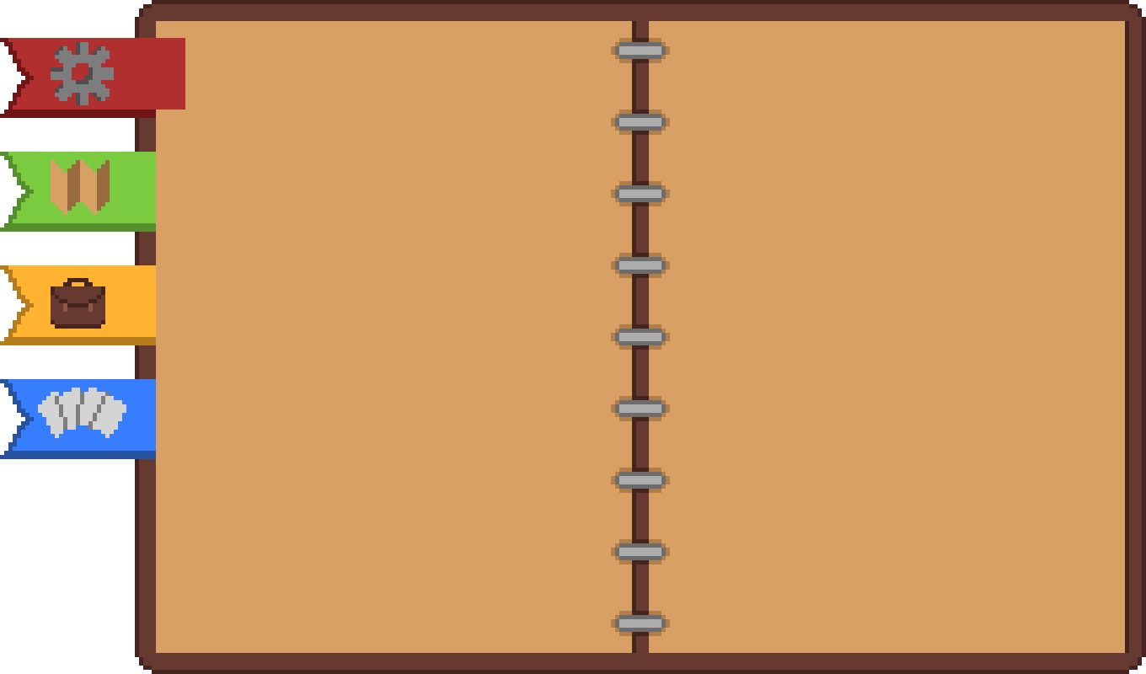
System Attributes
Attributes | Details / Restrictions (D / R) | Categories
Platforms | D – Unity, Mobile | Mandatory
Ease of use | D – simplistic, intuitive | Mandatory
Monetization | D – Ads, paid currency | Preferable
Graphics | D – 2D, Pixel art | Mandatory
Controls | D – Touch Controls | Mandatory
10/11

Slide 11
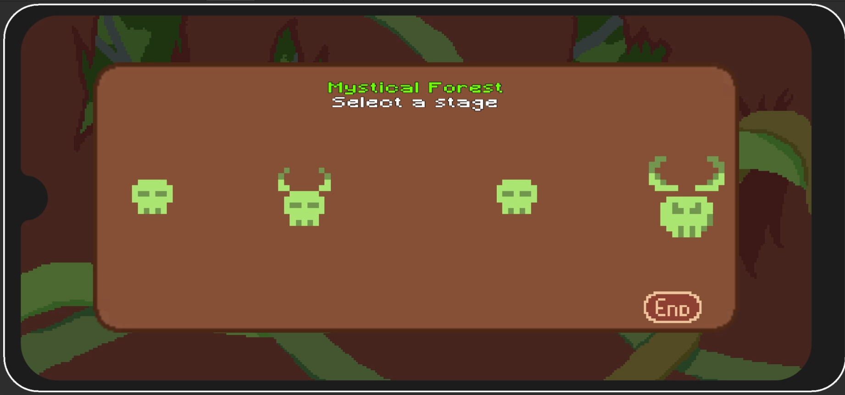
Game

Slide 12

Thanks
Do you have any questions?
André Faria A47455@alunos.isel.pt
Sara Nobre
A47504@alunos.isel.pt

